Slide 1
X
O
X
Tic-Tac-Toe with Minimax
and Alpha-Beta Pruning
O
X
O
X
CS5008 — Summer 2026
Xin Wang · Dan Liu

Slide 2
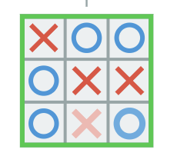
Introduction
Minimax is an algorithm for adversarial games: two players, opposite goals, full visibility of the board, taking turns.
It picks the best move by assuming the opponent always plays their best possible move back — the best guaranteed outcome, not just the best possible one.
We will use tic-tac-toe to see this in action, but the same idea applies to other more complex adversarial games, like chess.
two-players, zero-sum, perfect information
13

Slide 3
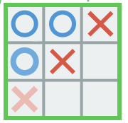
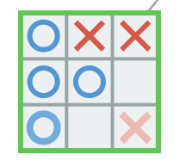
Terminal States
10
0
-10
Give each player a goal:
X player (MAX player) has the goal of maximizing the score: ideally 10, 0 if not
O player (MIN player) has the goal of minimizing the score: ideally -10, 0 if not
13

Slide 4
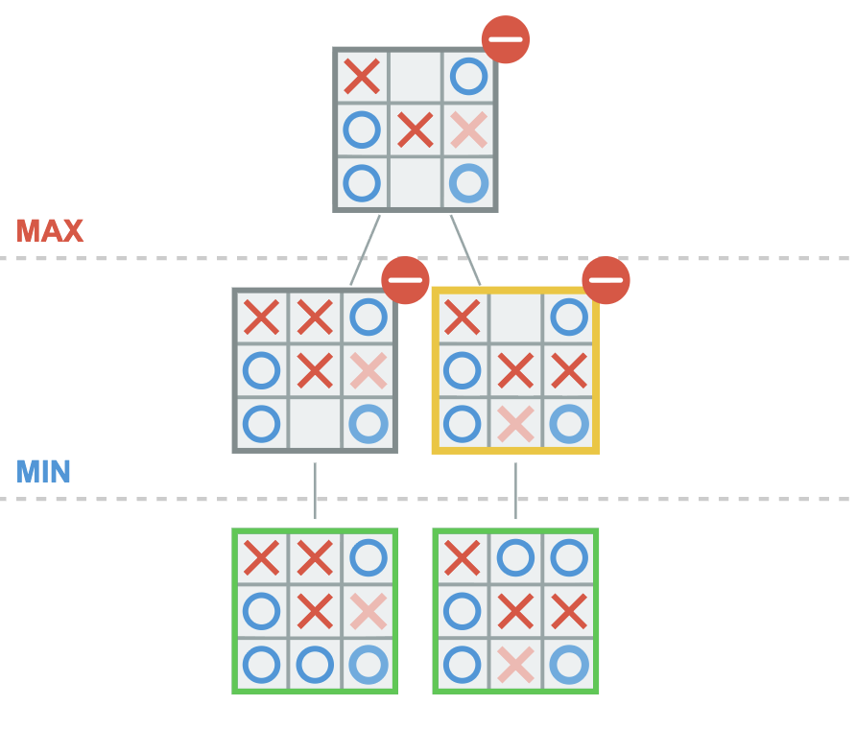
Non-terminal States
X’s turn to move.
X is the maximizer, and he wants the value to be as max as possible.
It’s not the terminal state, he needs to evaluate all the possible moves he can make and look at what the board will result from taking those actions.
-10
0
-10
0
13

Slide 5
Minimax Algorithm
Minimax(s, isMax):
if Terminal(s):
return Value(s)
if isMax:
maxValue = -infinity
for a in Actions(s):
value = Minimax(Result(s, a), false)
maxValue = Max(maxValue, value)
return maxValue
if !isMax:
minValue = infinity
for a in Actions(s):
value = Minimax(Result(s, a)), true)
minValue = Min( minValue, value)
return minValue
Whether a game state is terminal, meaning the game is over. Terminal(state) = true/false. If true, we need to get the Value(state).
Also need to whose turn it is in any given game state. isMax = true/false.
In a particular game state, we need to know what actions are available. Actions(state) = {move 1, move 2, move 3}.
Finally, we need Result(state, action), what state will be after taking that action.
14

Slide 6
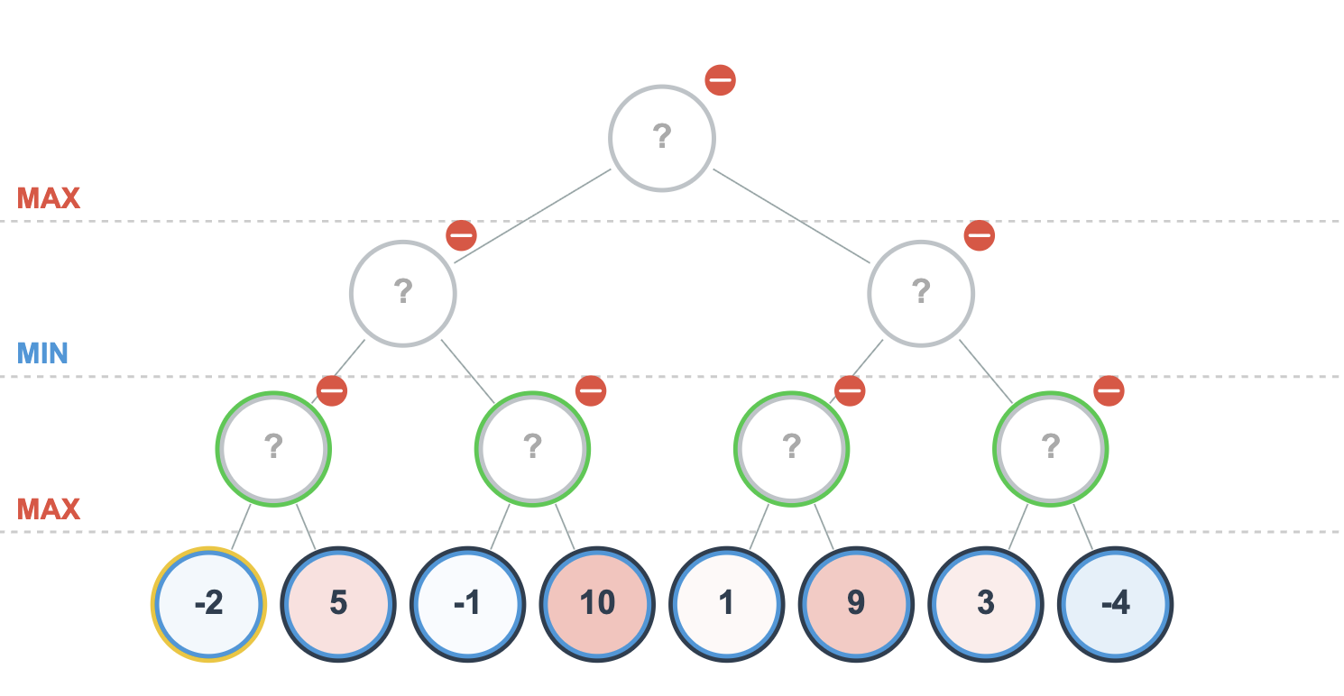
Minimax Algorithm
Max(?, ?)
5
Min(?, ?)
Min(?, ?)
5
10
Max(?, ?)
Max(?, ?)
14

Slide 7
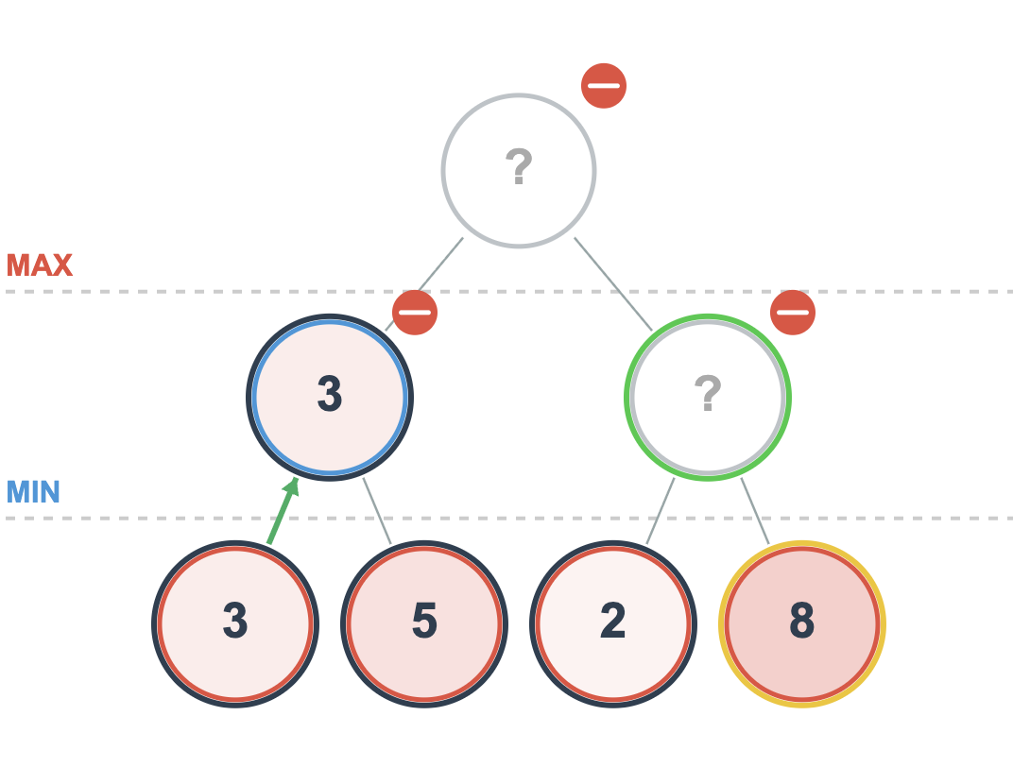
Alpha-beta Pruning
Max’s turn
Goal: Maximize the value
Question: Does he need to search the last leaf node?
Question: What is alpha and beta?
alpha = the highest value MAX has already guaranteed itself somewhere higher up.
beta = the lowest value MIN has already guaranteed itself somewhere higher up.
<=2
X
?
14

Slide 8
Minimax Algorithm with alpha-beta pruning
Minimax(s, alpha, beta, isMax):
if Terminal(s):
return Value(s)
if isMax:
maxValue = -infinity
for a in Actions(s):
value = Minimax(Result(s, a), alpha, beta, false)
maxValue = Max(maxValue, value)
alpha = Max(alpha, value)
if beta <= alpha:
break
return maxValue
if !isMax:
minValue = infinity
for a in Actions(s):
value = Minimax(Result(s, a)), alpha, beta, true)
minValue = Min(minValue, value)
beta = Min(beta, value)
if beta <= alpha:
break;
return minValue
14

Slide 9
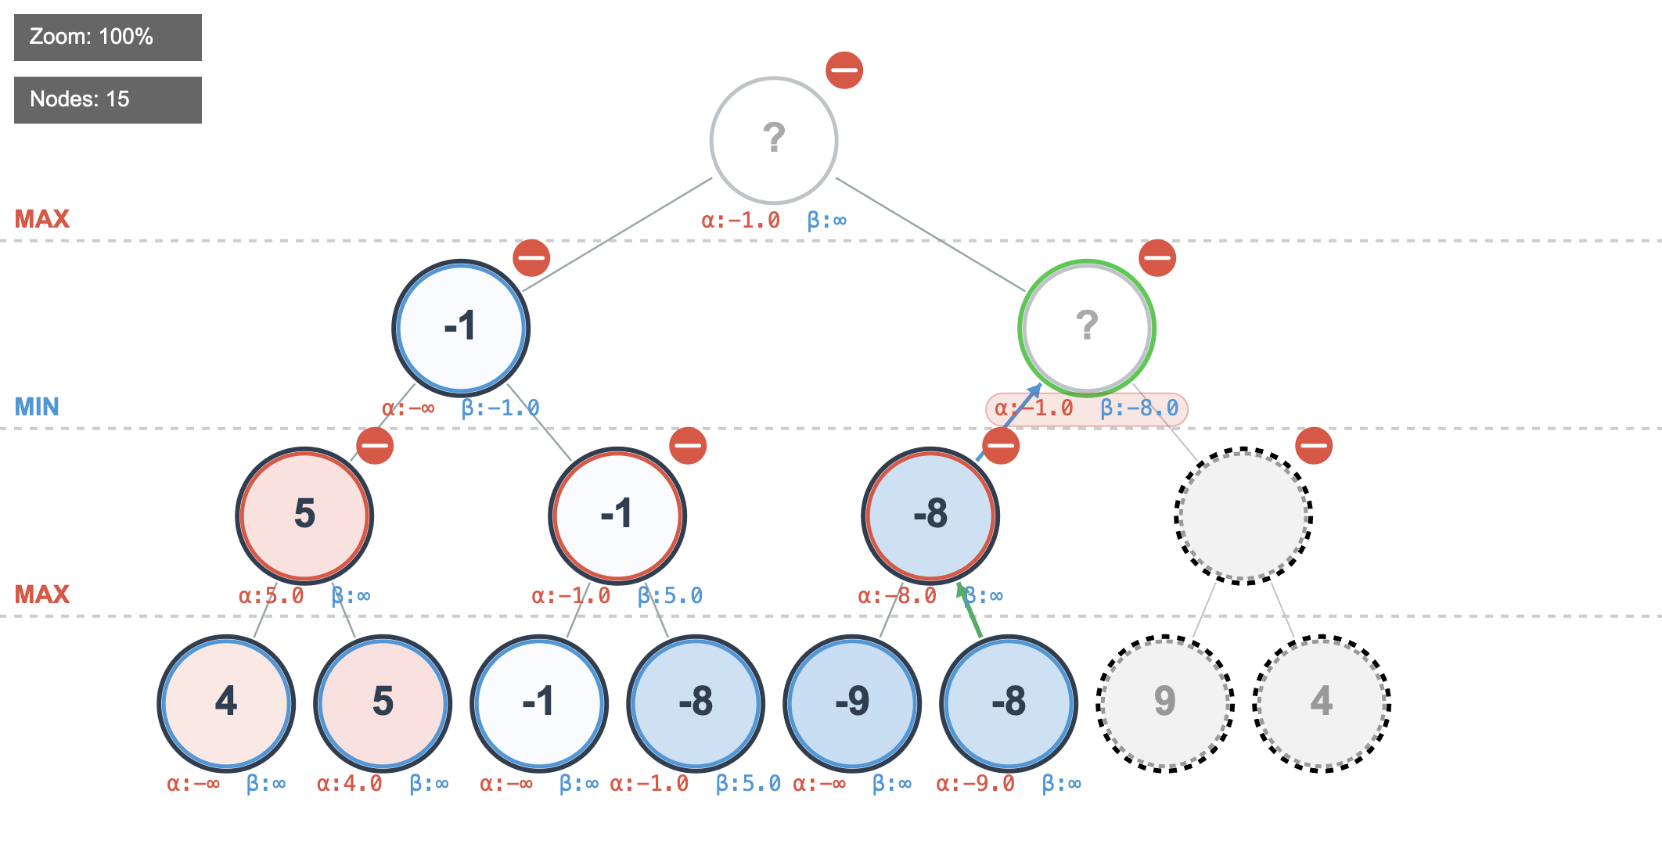
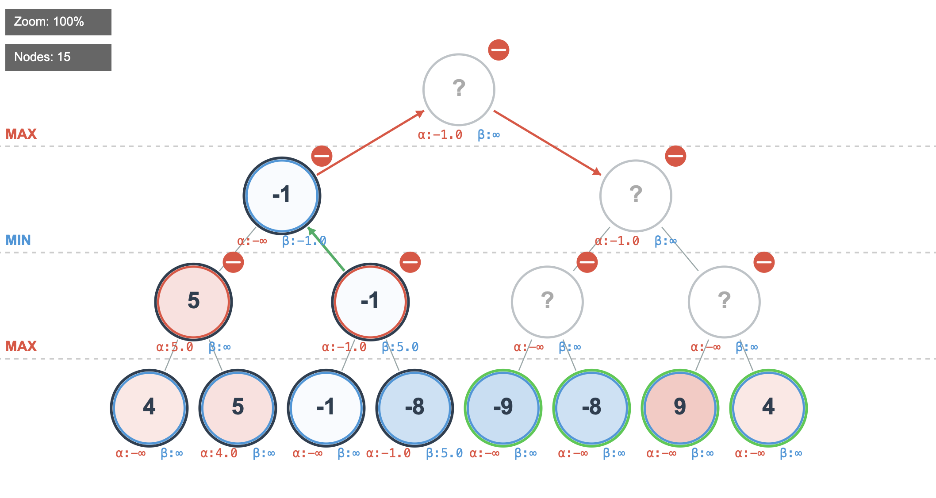
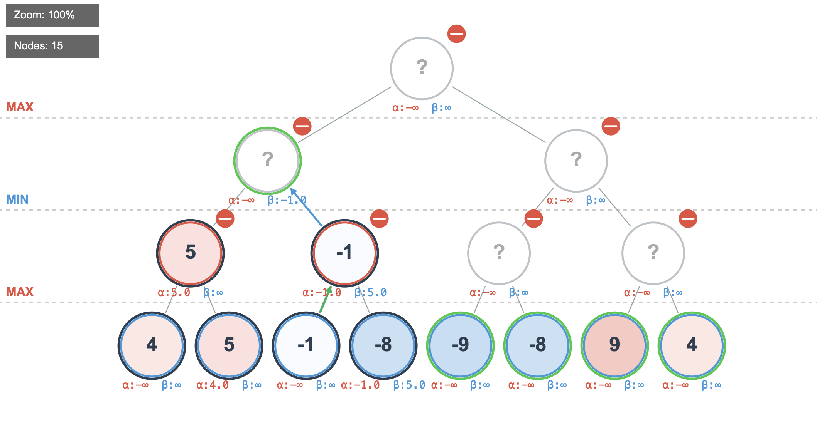
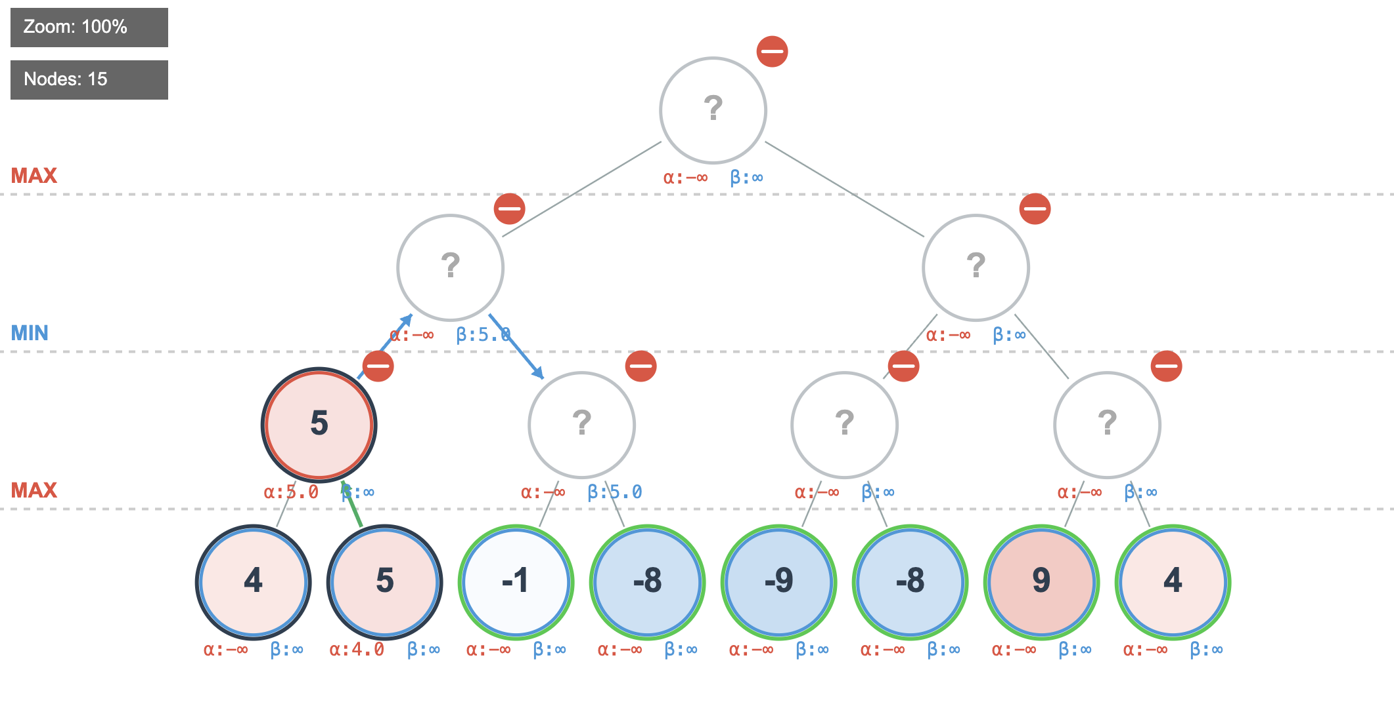
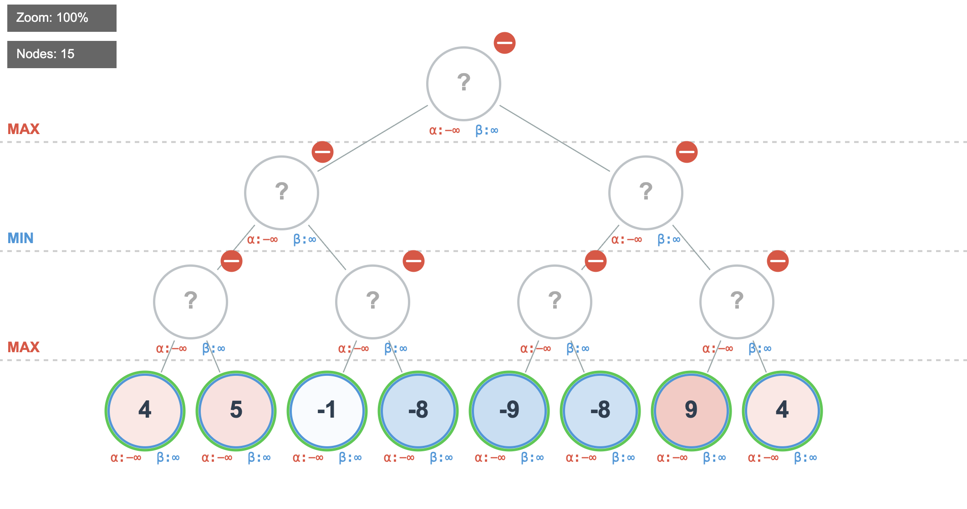
Minimax Algorithm with alpha-beta pruning
Source: https://ai-unboxed.de/html/playground/minimax-viz.html
14

Slide 10
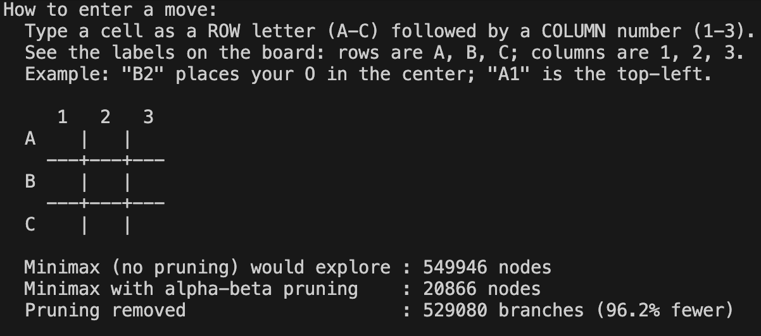
Play Time (tic-tac-toe)
When facing an empty board, we can see our AI explored 549,946 nodes without pruning → 20,866 with pruning (96.2% fewer). Per-move pruning stayed in the 55–96% reduction range throughout, shrinking as the board fills up (fewer empty cells → smaller tree) → pruning's relative benefit is highest early in the game.
The end-of-game summary (94.7% fewer nodes overall)
14

Slide 11
Reference
Wikipedia contributors. (n.d.). Minimax. In Wikipedia. Retrieved July 23, 2026, from https://en.wikipedia.org/wiki/Minimax
Wikipedia contributors. (n.d.). Alpha–beta pruning. In Wikipedia. Retrieved July 23, 2026, from https://en.wikipedia.org/wiki/Alpha%E2%80%93beta_pruning
Lague, S. (2018, April 20). Algorithms Explained – minimax and alpha-beta pruning [Video]. YouTube. https://youtu.be/l-hh51ncgDI
Galli, K. (2018, July 14). How does a Board Game AI Work? (Connect 4, Othello, Chess, Checkers) – Minimax Algorithm Explained [Video]. YouTube. https://youtu.be/y7AKtWGOPAE
Aradhya, A. L. (n.d.). Minimax algorithm in game theory | Set 1 (Introduction). GeeksforGeeks. Retrieved July 23, 2026, from https://www.geeksforgeeks.org/dsa/minimax-algorithm-in-game-theory-set-1-introduction/
Aradhya, A. L. (n.d.). Minimax algorithm in game theory | Set 4 (Alpha-Beta Pruning). GeeksforGeeks. Retrieved July 23, 2026, from https://www.geeksforgeeks.org/dsa/minimax-algorithm-in-game-theory-set-4-alpha-beta-pruning/
Aradhya, A. L. (2022, April 29). Minimax algorithm in game theory | Set 3 (Tic-Tac-Toe AI – finding optimal move). GeeksforGeeks. Retrieved July 23, 2026, from https://www.geeksforgeeks.org/dsa/finding-optimal-move-in-tic-tac-toe-using-minimax-algorithm-in-game-theory/
14

